Slide 1
GradMatch
Developing the product
Product Owner: Awoyomi Oluwademilade
© 2019 Udacity. All rights reserved.

Slide 2
Create Project Blueprint
A product launch is not just about deploying a beautifully designed,built and thoroughly tested feature. Your company needs to be equally prepared if not more to support every possible customer interaction associated with the product (e.g landing on your company website to learn more about the new feature)
© 2019 Udacity. All rights reserved.
Notes:
[ALL PARTICIPATION]

Slide 3
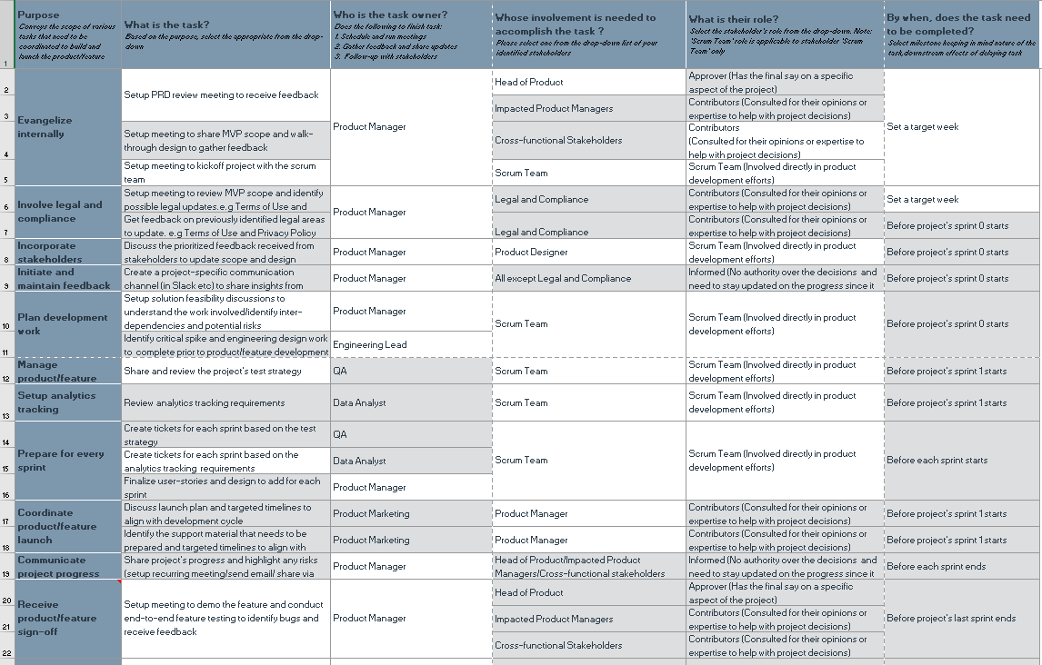
Create a coordination activities map
Share your project-specific coordination activities map here (Insert Link here). You can also share a screenshot below.
© 2019 Udacity. All rights reserved.

Slide 4
Plan for Sprint Meeting
As a PM, it is important to stay ahead of your scrum team and be prepared for every upcoming sprint by having a target goal defined with prioritized backlog for team to start costing and breaking down the tasks
© 2019 Udacity. All rights reserved.
Notes:
[ALL PARTICIPATION]

Slide 5
Sprint Planning Meeting Preparation
Sprint Goal
Auto-recommendation of jobs to users based on Profile (skills & preferences)
Sprint Backlog (list the prioritized user-stories from the product backlog)
1 | As a recent college graduate, I want the app to automatically recommend job listings that match my skills and profile, so that I can discover relevant opportunities without having to manually search for them
2 | As a user, I want to be able to customize the job preferences in my profile, including desired industry, location, and salary range, so that the auto-recommendation algorithm takes my specific preferences into account.
3 | As a job seeker, I want to provide feedback on recommended jobs (like or dislike), so that the app can learn my preferences and improve the accuracy of future recommendations.
4 | As a user, I want to receive real-time notifications when new job recommendations that match my profile become available, so that I can stay informed and be among the first to apply.
5 | As a recent graduate, I want the app to suggest relevant skills to add to my profile based on the job market trends and demand, so that I can enhance my profile and increase my chances of getting relevant job recommendations.
Sprint Prioritization Logic
Develop the core functionality of the auto-recommendation feature in the first sprint to ensure it's working effectively from the outset. Prioritize the development of the API integration with LinkedIn job postings, as this will be essential for retrieving and filtering the right jobs from the entire job offerings.
© 2019 Udacity. All rights reserved.

Slide 6
User Story 1
User Story | As a recent college graduate, I want the app to automatically recommend job listings that match my skills and profile, so that I can discover relevant opportunities without having to manually search for them
Design | See next slide
Acceptance Criteria | A logged-in user can find the newly added auto-recommendation feature prominently displayed on the app's home screen. The auto-recommendation feature will be positioned above the existing job search functionality. The page layout and design will be mobile responsive, ensuring a seamless user experience across devices. The feature will adhere to ADA compliance guidelines, ensuring accessibility for users with disabilities.
Assumptions | GradMatch app is already built to be ADA compliant and mobile responsive, so the engineering team will continue to develop new features while maintaining these requirements. The initial launch of the GradMatch app will target users in the United States, and the MVP (Minimum Viable Product) will be available in English only.
© 2019 Udacity. All rights reserved.

Slide 7
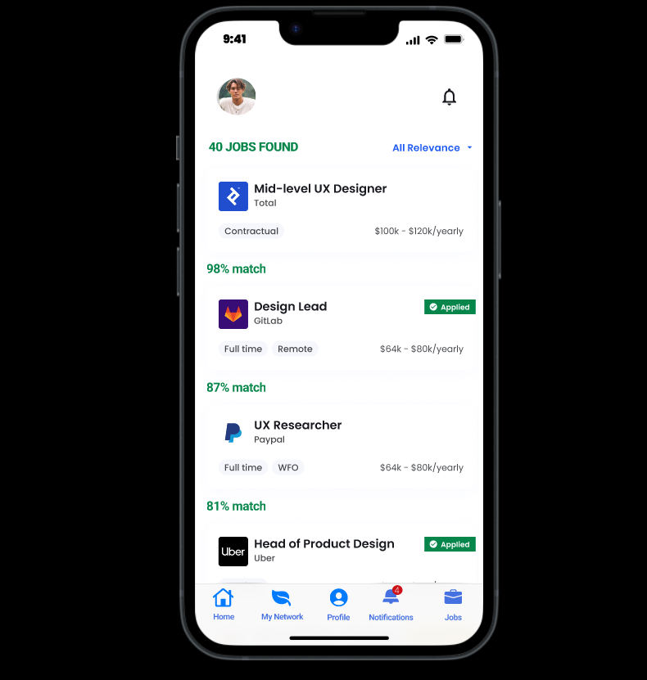

Slide 8
User Story 2
User Story | As a user, I want to be able to customize the job preferences in my profile, including desired industry, location, experience, education etc.. so that the auto-recommendation algorithm takes my specific preferences into account.
Design | See next slide
Acceptance Criteria | The app provides a user-friendly interface where I can easily access and update my job preferences within my profile settings. I can select and specify my preferred industry, such as technology, finance, healthcare, etc., to ensure that the auto-recommendation algorithm focuses on relevant job opportunities in my desired field. I have the option to specify my preferred location or locations, allowing the algorithm to consider jobs available in specific cities, regions, or remote work options. I can indicate my desired level of experience, such as entry-level, mid-level, or senior positions, so that the algorithm can prioritize job recommendations accordingly. The app allows me to input my education details, including degree, field of study, and educational institution, enabling the algorithm to consider jobs that match my educational background.
Assumptions | The user profile settings already exist within the app, providing a framework to incorporate job preference customization. The app is developed to handle various user inputs for job preferences and utilize them effectively in the recommendation process.
© 2019 Udacity. All rights reserved.

Slide 9
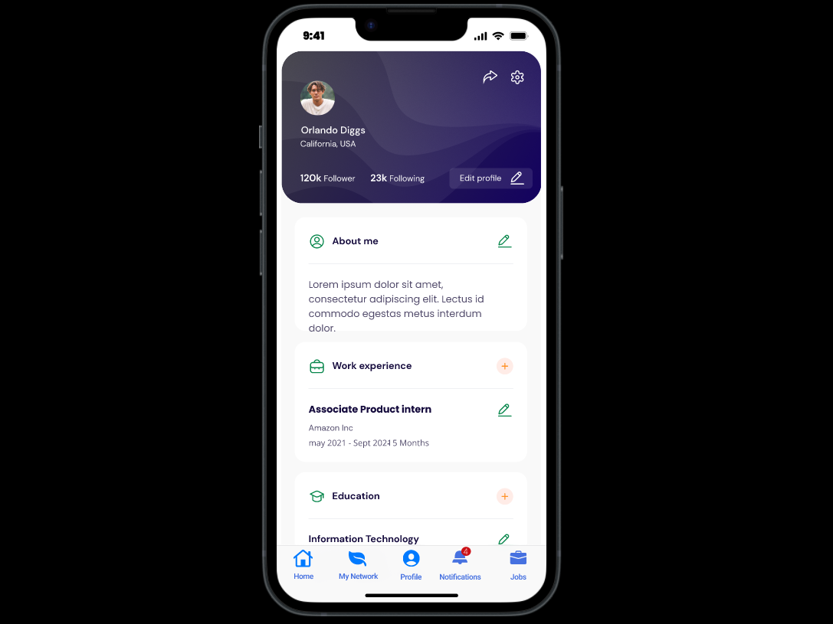

Slide 10
Decoding API Documentation
As a PM, you will collaborate with the engineering team and provide guidance that heavily influences their development approach. When a product requires an API integration, sometimes PM need to be “technical enough” to understand the following to refine the solution with designer and development team
what information is available via the API
how is it available
possible pricing impact
© 2019 Udacity. All rights reserved.
Notes:
[ALL PARTICIPATION]

Slide 11
GradMatch Project
Based on the API documentation how would you update your solution and design? | With the LinkedIn Job Search API, GradMatch can directly fetch job listings from LinkedIn's extensive database, ensuring a broader range of job opportunities for users. GradMatch can explore the LinkedIn Talent Solutions APIs to enhance the candidate discovery and recruitment features
Based on your high-level understanding of the API documentation, are there any details that you want to discuss with engineering to refine solution and/or determine feasibility | What are the authentication and authorization mechanisms required to access the LinkedIn APIs? How can we ensure secure and authorized access to user data? Are there any rate limits or usage restrictions imposed by the LinkedIn APIs that we need to consider in terms of scalability and performance?

Slide 12
Re-prioritize Sprint Backlog
As a PM, unexpected issues and new feature requests will require you to triage them efficiently and re-prioritize the sprint backlog without impacting the roadmap deliverables significantly
© 2019 Udacity. All rights reserved.
Notes:
[ALL PARTICIPATION]

Slide 13
Issue 1: Landing Page loading too slow
Determine impact and criticality to prioritize issue | Analyze server response time, page load time, and other performance metrics using related tools. Examine network requests and response times using browser developer tools or network monitoring tools Check with QA on Unique visitors: can we see on a daily basis a significant decreasing demand? How many users are affected? The issue of Landing Page loading too slow should be prioritized as High. This is because it directly impacts user experience, conversion rates, and puts GradMatch at a competitive disadvantage
Next Steps You would carry out typically using JIRA (ticketing tool), communication channel (Slack) | Change the priority of the Landing Page loading issue to "High" or "Critical" in JIRA to reflect its urgency and criticality. Include the Landing Page loading issue as a hotfix in the current sprint's backlog in JIRA, prioritizing it for immediate resolution Send a notification to the development team via Slack, informing them about the updated priority of the Landing Page loading issue.
Would you take additional steps ? | Conduct a thorough root cause analysis with QA to identify the underlying factors contributing to the slow loading of the Landing Page. Based on the root cause analysis, work with the development team to implement preventive measures such as code optimizations, server infrastructure upgrades and caching mechanisms.
© 2019 Udacity. All rights reserved.

Slide 14
Issue 2: Misaligned fields in Profile Settings
Determine impact and criticality to prioritize issue | Gather user feedback and complaints related to the misaligned fields in Profile Settings. Assess the impact on user experience and functionality caused by the misaligned fields. Determine if it affects essential tasks or core functionality of the application The misaligned fields in Profile Settings have a significant impact on user experience and can lead to user frustration, potentially affecting user engagement and satisfaction. Priority can be maintained as high
Next Steps use ticketing tool (JIRA), and communication channel (Slack) | Update the priority of the misaligned fields in Profile Settings issue to "High" on JIRA Send a notification to the development team via Slack, highlighting the updated priority of the misaligned fields in Profile Settings issue. Share the expected timeline for addressing the issue and any follow-up communication plans to keep stakeholders informed.
© 2019 Udacity. All rights reserved.

Slide 15
Respond to Customer Service Manager’s Email
Determine impact and criticality to prioritize the issue (1 - Critical; 2 - High; 3 - Normal; 4 - Low) | The issue is identified as a critical priority issue affecting 7% of the total users of GradMatch Retention rate is down 20% due to issue meaning immediate fix is needed. Check with QA on why password reset email issue of delay The issue of password reset email delay is urgent and should be tagged as 1- critical, needing immediate fix.
Next Steps You would carry out typically using JIRA (ticketing tool), communication channel (Slack) | Update the priority of the password reset link issue to “critical” in JIRA. Include the password reset link issue as a hotfix in the current sprint's backlog in JIRA, prioritizing it for immediate resolution Send a notification to the development team via Slack, highlighting the updated priority of the password reset link issue.
Sample Email Response | Dear Customer Service Manager, We appreciate you informing us of the specifics and gravity of the problem. We are now looking into the reason why this email to our customers was sent out late with Engineering and DevOps. This is a crucial topic, therefore we'll focus on it first. While waiting, we discovered a solution for our clients, which we wish to share with you: Customers can use the product on their own to ask for a password reset email. This email was sent out without delay after QA verification. Customers can currently be sent there. That ought to assist you and the customer as we work to fix the problem using our internal tool. Kind regards, PM Demi
© 2019 Udacity. All rights reserved.

Slide 16
Handle Potentially Difficult Situations
As a PM, you will be faced with many unexpected situations where you have to make a decision or push back while managing competing priorities from stakeholders and tackling issues that could potentially affect your product launch
© 2019 Udacity. All rights reserved.
Notes:
[ALL PARTICIPATION]

Slide 17
Respond to CEO or GM’s request via email
Assessment and result | The development team reviewed the feature, which is 65% functional. Additionally, confirm with the QA on staging environment whether portions of the feature have been thoroughly tested and are operational. Deployment of current level of feature in two days on staging will make it possible to test, but will need guidance of product manager
Sample Email Response | Dear CEO, The opportunity to see a demo of this functionality in two days is amazing and fantastic. We are now in the middle of the sprint, and neither our staging environment nor our QA environment have fully tested and stabilized the feature. Our team puts a lot of effort into meeting sprint targets to make this product completely available in the coming week as well as business values for our clients. For your demo, we will deploy the current functionality to staging in its current state, however if you wouldn't mind, it might be unstable. You can log in to the demo using this feature or URL. Please log in using this username and password. Regards, PM Demi
© 2019 Udacity. All rights reserved.

Slide 18
Step-in and guide the scrum team at stand up
Video Response | https://drive.google.com/file/d/1lI9-mHtiS87izRXv4kH8g3wJqoXGuHrh/view?usp=share_link
© 2019 Udacity. All rights reserved.

Slide 19
Handling Resource Constraints
List 2- 3 activities that you would carry out as a PM to unblock the scrum team immediately ? | PM assumes the role of QA and completes the manual tests as soon as they are ready Discuss with the development team whether anyone can assist with automated tests and share their time by re-prioritizing tickets Discuss with the impacted PMs whether engineers can act as testers (e.g., through resource trading)
Since the QA team member is shared across multiple projects, how would you coordinate with other PMs to de-risk your project and raise appropriate visibility ? | Set-up a meeting with impacted PMs and head of QA via email ,notify impacted stakeholders and head of product afterwards informing them about a feature at risk for launch Highlight tickets that can be pushed back for QA and identify crucial tickets for sprint goals for immediate implementation
Since there is a potential risk, it is important to raise visibility amongst appropriate stakeholders | Head of Product Cross-functional stakeholders
 | ● Analyzing the timing of initiation, considering successful negotiations, and providing necessary details and assistance to support new QA. We also hope to share updates as soon as initial QA gets back on track to offset the backlog of the affected projects. ● If negotiations go awry, we acknowledge our disagreements and seek feedback that it is possible to make some changes to our requirements, then renegotiate.
© 2019 Udacity. All rights reserved.

Slide 20
How would you handle stakeholder feedback?
Feedback Assessment | ●This is a great feature however why is the notification feature crucial at this stage of a MVP and what is the specific trigger for a notification? ● What is the expected result of this feature? ● Does this new feature fit into your sprint goals?
Video Response | https://drive.google.com/file/d/1m04fAUZxglLO2q1z-L8H4RIW7T0xq9PR/view?usp=share_link
© 2019 Udacity. All rights reserved.

